Slide 1
Local Search, Part 3 Lecture 10 Chapter 4, Sections 4.2-4.4
Jim Rehg
College of Computing
Georgia Tech
February 5, 2016

Slide 2








Why is the Gradient the Direction of Steepest Descent?
Local model for f(x) at x=a :
Directional Derivative along $u$ at x=a :
$$a$$
$$θ$$
$$u$$
$$\tilde{f}\left(x\right)=f\left(a\right)+\frac{∂f}{∂x_{1}}\left(a\right)\left(x_{1}−a_{1}\right)+⋯+\frac{∂f}{∂x_{n}}\left(a\right)(x_{n}−a_{n})$$
$$∇_{x}f(a)$$
$$D_{u}f\left(x\right)|_{x=a}=\lim_{h→0}{\frac{f\left(a+hu\right)−f(a)}{h}}$$
$$=\lim_{h→0}{\frac{\tilde{f}\left(a+hu\right)−f(a)}{h}}=\lim_{h→0}{\frac{\frac{∂f}{∂x_{1}}\left(a\right)hu_{1}+⋯+\frac{∂f}{∂x_{n}}\left(a\right)hu_{n}}{h}}$$
$$=\frac{∂f}{∂x_{1}}\left(a\right)u_{1}+⋯+\frac{∂f}{∂x_{n}}\left(a\right)u_{n}=∇_{x}f(a)∙u$$
$$∇_{x}f\left(a\right)∙u=∇_{x}f\left(a\right)\cos{θ}$$
Maximized when
$$u=∇_{x}f\left(a\right)$$

Slide 3
Gradient Descent – Shape of Energy Landscape
Gradient descent can get bogged down in narrow valleys, bouncing between walls while making slow forward progress

Slide 4
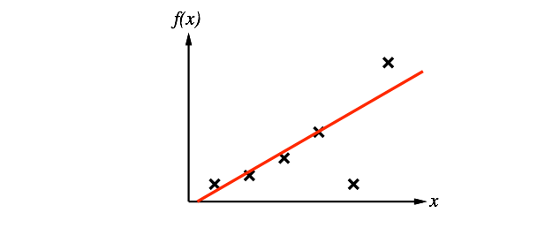

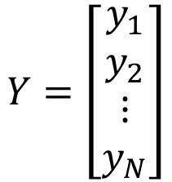
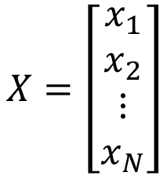
Normal Equations for Linear Regression
$$θ={(X^{T}X)}^{−1}X^{T}Y$$
$$X=\left[\begin{matrix}x_{1} \\ x_{2} \\ \begin{matrix}⋮ \\ x_{N}\end{matrix}\end{matrix}\right]$$
$$Y=\left[\begin{matrix}y_{1} \\ y_{2} \\ \begin{matrix}⋮ \\ y_{N}\end{matrix}\end{matrix}\right]$$
N data
points
Rows of x
values
Target y
values
Since closed-form solution exists, why use gradient descent?

Slide 5
Motivations for Using Gradient-based Local Search

Slide 6
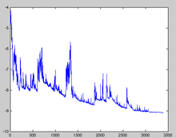
Motivations for Using Gradient-based Local Search
Data set may not fit in memory
Matrix inversion can be expensive for large N
Stochastic Gradient Descent
Randomly sample a subset of data points (mini-batch)
Perform gradient descent using the sample only
Repeat
Extreme version:
Take a step from a single data point

Slide 7
Simulated Annealing
Compute the local search step
Accept that step with probability 1-T
Otherwise, pick a neighbor at random
Deliberate strategy to escape local minima
Slowly reduce T over time (annealing)
Can be efficient for discrete problems
Use stochastic gradient methods for continuous problems

Slide 8
Gradient Descent with Random Restarts
Pick a starting point at random
Find local minima
Repeat
Choose the minimum among the minima
Surprisingly effective method for complex energy landscapes
Can often beat more complex methods
Heuristics can be used to bias towards good starting points

Slide 9
Non-Deterministic Actions
Actions are no longer guaranteed to produce the desired output
Different cases:
Actuation error – Output is offset from target goal by some delta
Actuation failure – No action taken or wrong action taken
The solution produced by search is a contingency plan, specifying what to do under different conditions.
We use sensing (percepts) to determine which action (among multiple contingencies) to take during execution
Notes:
Note that before during classical search once we obtained a solution we could simply follow the resulting sequence of actions blindly (an approach sometimes termed “open loop” because it doesn’t involve any feedback). In the Romania example, once we found the route to our destination city we could follow it directly. In a non-deterministic world, a major accident could close down a roadway, preventing us from taking the planned path. If we had accounted for non-determinism at the search stage, then we would have stored a back-up plan and would be prepared to immediately take an alternate route. If we had not accounted for this, we could stop the execution of our plan and run search again (this is an example of on-line search).

Slide 10
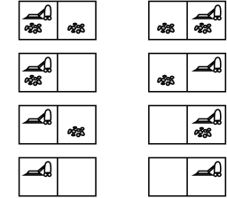
Erratic Vacuum Example
Sometimes the action “suck” in a dirty square cleans an adjacent square as well (Transition from 1 to 7)
Sometimes “suck” deposits dirt when applied to a clean square (Transition from 5 to 1)
Use AND-OR search tree to solve these problems
1
2
3
4
5
6
7
8

Slide 11
AND-OR Search
Alternating rows of action (OR) and chance (AND) nodes
OR nodes – Agent chooses best action (as before)
AND nodes – Execution of chosen action is non-deterministic (random), multiple successors are possible
Searching the tree produces a strategy that is resilient to non-determinism
a1
a2
OR
?
?
AND
OR
Notes:
Note that after selecting a particular action (say a1) at an OR node and encountering a chance node, we will choose the best action to take for each of the states produced by the AND node. Thus we will know which action to take next regardless of the outcome of the chance node, and we will use our percepts at execution time (run-time) to determine which action was produced for each AND node.

Slide 12
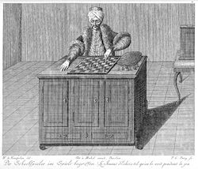
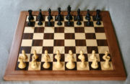
Building AI Agents to Play Games – Long History
1770: Kempelen -- Mechanical Turk
1912: Zermelo -- paper that first mentions an algorithm like Minimax (for optimal game play)
1951: Turing -- first chess program
1952: Samuel -- uses ML to improve
1956: McCarthy -- pruning to allow deeper search with efficiency
1997: Deep Blue beats Kasparaov with great evaluation functions

Slide 13
Online Search
Offline Search:
Simulate the world and search for a complete sequence of actions to achieve the goal, then execute them
Online Search:
Interleave search (planning) and execution
Search to determine an action,
execute action,
search again, …

Slide 14

When to Use On-Line Search?
In a dynamic environment,
things change too quickly for a static plan
In a non-deterministic environment,
deal with what actually happens rather
than planning for all contingencies
In an unknown environment,
affect of actions is unknown until they
are executed
Notes:
In a situation where the environment is unknown and/or dynamic (as in the case of the movie Maze Runner where a group of teens are forced to explore an unknown maze whose walls are constantly changing) online search is the only feasible alternative.

Slide 15
Elements of On-Line Search
Actions(s) – Returns the allowable action choices for state s
Goal-Test(s) – Determines whether s is a goal state
C(s,a,s’) – Cost of executing (allowable) action a from state s, resulting in state s’
Notes:
Note that in general the function Result(s,a) will not be available in advance and can only be learned from experience. Only after being in state s and selecting action a can the result of that action be known (and in non-deterministic case multiple trials might be needed to learn a probability distribution over outcomes).

Slide 16
Issues in Online Search
Unpredictable consequences of actions
Irreversible actions
Dead ends
Environment has to be safely explorable

Slide 17
Learning Real-Time A* (LRTA*)
Guaranteed to find a goal in any finite safely-explorable environment
Learns Result(s,a) through experience
Updates heuristic function H(s) based on experience, try to avoid
being stuck in local minima
Always chooses the lowest cost action
Connections to reinforcement learning

Slide 18
Questions?

